Slide 1

Career Catalyst
Catalyze Your Career With AI Precision
Transforming the way job seekers navigate their career journey through intelligent automation and personalized guidance.

Slide 2




The Modern Job Hunt is Broken
Today's job market presents unprecedented challenges for talented professionals seeking their next opportunity. The application process has become a frustrating maze of repetitive tasks, algorithmic gatekeepers, and missed opportunities.
Time-Consuming Customization
ATS Black Hole
Job seekers spend 3-4 hours crafting a unique resume for each application, leading to exhaustion and fewer applications submitted.
75% of resumes are automatically rejected by Applicant Tracking Systems before any human recruiter reviews them.
Skills Mismatch Confusion
Cover Letter Roadblock
Candidates struggle to identify which qualifications and experiences to emphasize for specific roles and industries.
Creating compelling, personalized cover letters from scratch becomes a major barrier that prevents applications from being completed.

Slide 3

Introducing Career Catalyst
The Solution You've Been Waiting For
Career Catalyst is an all-in-one, AI-powered platform designed to streamline your job application process and significantly boost your chances of landing an interview. We combine cutting-edge artificial intelligence with intuitive design to eliminate the friction in modern job searching.
Our platform empowers job seekers to apply to more positions with higher quality applications in less time. By automating the tedious aspects of job applications while maintaining personalization and authenticity, Career Catalyst helps you focus on what matters most: preparing for interviews and landing your dream role.
Transform hours of work into minutes, and turn rejections into interviews.

Slide 4
Core Features That Set Us Apart
Career Catalyst offers a comprehensive suite of AI-powered tools designed to address every challenge in the modern job application process.
1
2
Resume From Scratch
AI Resume Tailor
Build a professional, ATS-friendly resume from the ground up using our intuitive builder. Choose from industry-specific templates, receive real-time formatting guidance, and create a strong foundation for all future applications.
Instantly customize your resume for any job description with one click. Our AI analyzes the posting and intelligently reorganizes, rephrases, and highlights your most relevant skills and experiences to match exactly what employers seek.
3
4
ATS Evaluator & Skill Gap Analysis
Cover Letter Generator
Get an instant ATS compatibility score for your resume against any job description. Identify crucial missing keywords, discover skill gaps, and receive specific recommendations to improve your match percentage.
Generate personalized and impactful cover letters in seconds. Our AI crafts compelling narratives tailored to the specific job, company culture, and your unique background, making each application stand out.

Slide 5



How It Works: The Technology Behind Career Catalyst
User Interface
Backend Processing
AI Engine
Job seekers interact through our React-powered frontend, experiencing a dynamic and responsive interface that makes complex tasks feel simple and intuitive.
Spring Boot REST APIs handle all business logic, user authentication, data management, and orchestrate communication between frontend and AI services.
Python scripts powered by the Gemini API perform intelligent content generation, resume analysis, keyword extraction, and personalized recommendations.
This architecture ensures fast response times, scalable performance, and the highest quality AI-generated content. Data flows seamlessly: users submit their information and job descriptions through the browser, our backend validates and processes the request, the AI engine generates or analyzes content using advanced language models, and results are instantly delivered back to the user in an actionable format.

Slide 6
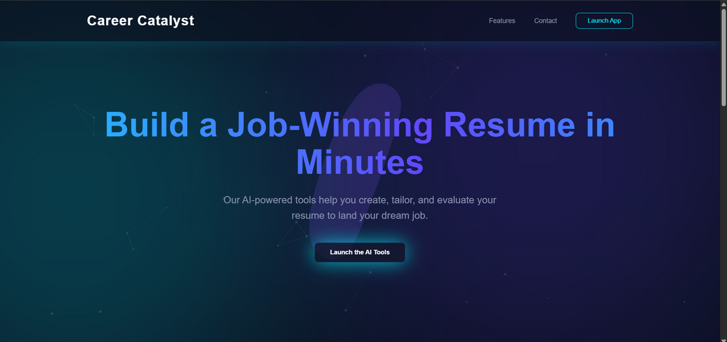
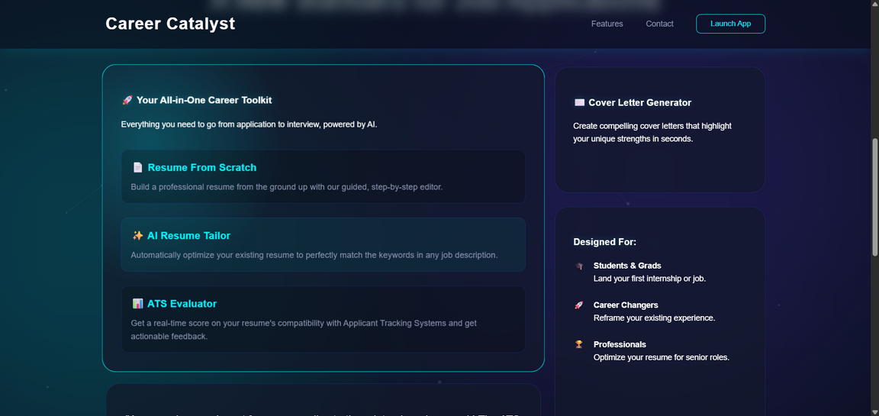
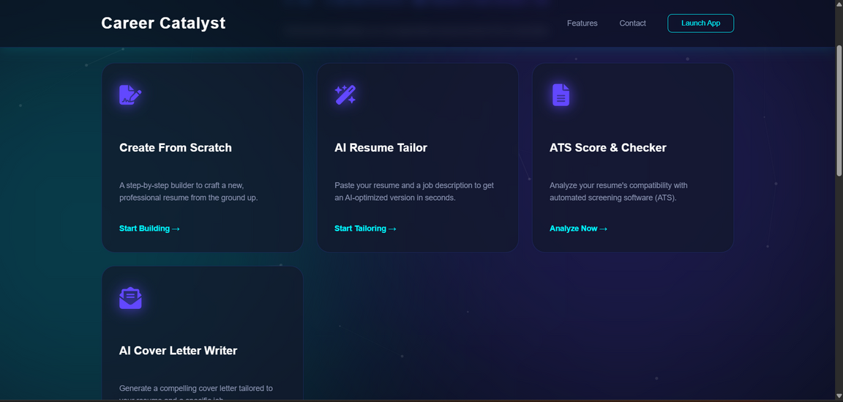
Screenshots /Preview
Python AI Integration
Flexible scripting layer connecting to the Gemini API for advanced natural language processing and intelligent content generation.

Slide 7

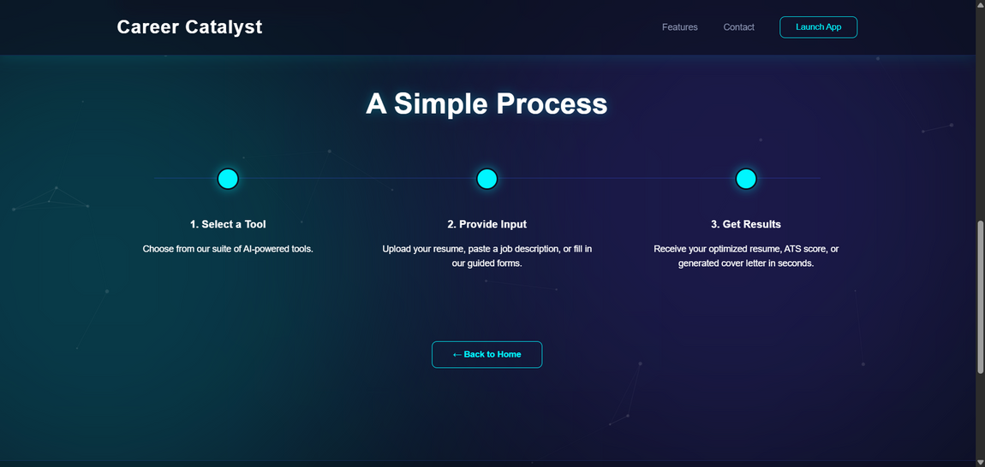
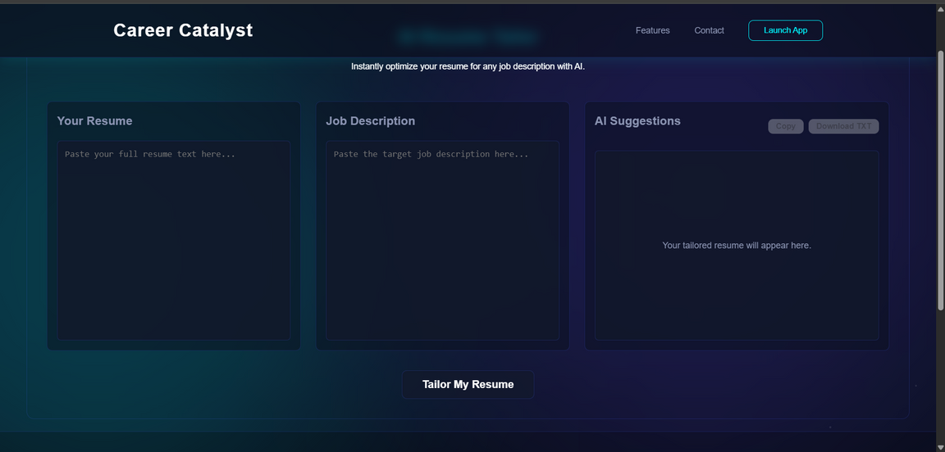
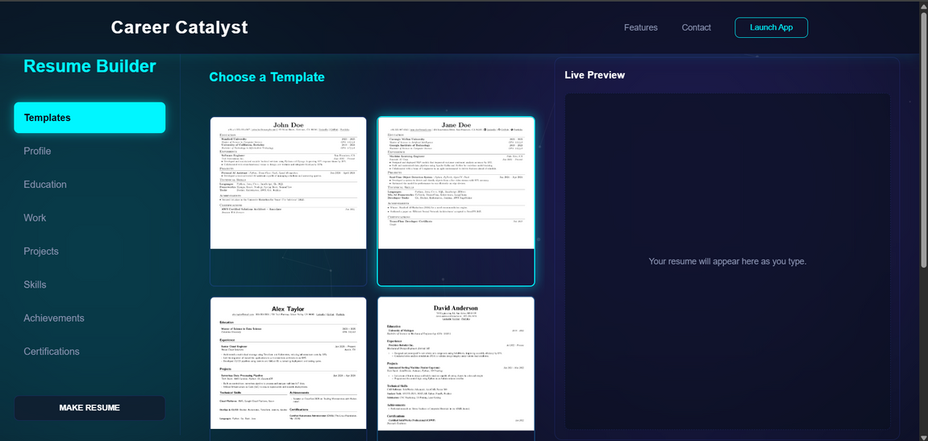
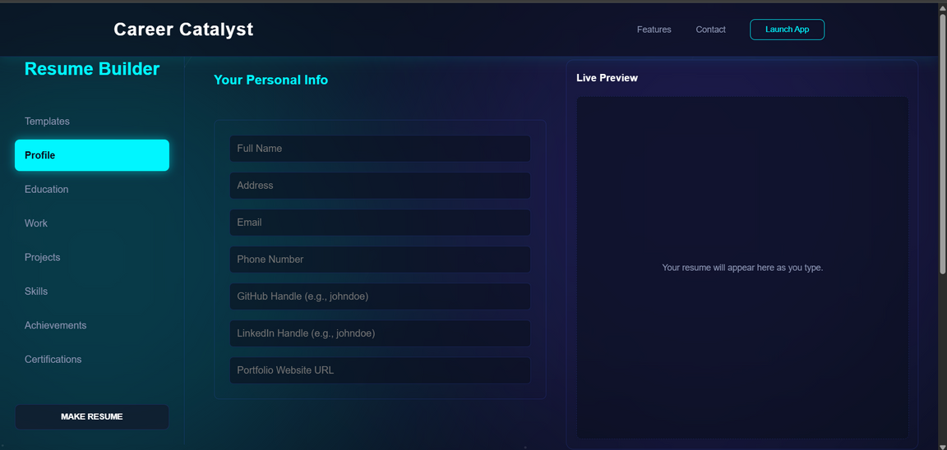

Slide 8
The Future of Career Catalyst
We're just getting started. Our roadmap includes powerful new features that will make Career Catalyst an indispensable career companion throughout your professional journey.
AI-Powered Interview Prep
1
Practice with AI-generated interview questions tailored to your target role. Receive feedback on your answers, learn optimal response frameworks, and build confidence before the big day.
2
LinkedIn Profile Optimization
Automatically fetch your LinkedIn data and receive AI recommendations to enhance your headline, summary, and experience sections. Generate engaging post ideas to build your professional brand.
Project & GitHub Suggestions
3
Get personalized recommendations for impactful projects to build based on your target roles. Strengthen your portfolio with relevant experience that catches recruiters' attention.
4
Career Path Recommendation Engine
Receive personalized guidance on career trajectories based on your skills, interests, and market demand. Identify skill gaps and get learning recommendations to reach your goals.

Slide 9

Ready to Catalyze Your Career?
For Job Seekers
Join us today and transform your job search. Get your first tailored resume and cover letter free.
For Investors
Join us in revolutionizing career development. Let's discuss how Career Catalyst can scale to millions of users.
Thank You
We're excited to answer your questions and explore how Career Catalyst can help job seekers land their dream roles faster and with more confidence than ever before.

